Slide 1
Multiplication & Division
Dr. Fatemah K Al Assfor

Slide 2
Multiplication of Unsigned Integers
There are three types of high speed multiplier:
* Parallel Multiplier ( Very fast )
* Sequential Multiplier (used in DSP applications)
* Array Multiplier
Sequential Multiplier
* Used in small systems, where high speed operation is unnecessary.
* It generates partial products sequentially and adds each newly generated product to previously accumulated partial product (PR).
Note
The key of this approach is that the sum of appropriately shifted multiplicand.
Example: Design 4X4 unsigned multiplier (Assume M=5₁₀ and Q=12₁₀)
Multiplicand (M) size (in bits)
Multiplier (Q) size (in bits)
Product size = 2*4 = 8bit

Slide 3
Note The sequential multiplier has 3- registers:
* A: Accumulator (initially cleared to zero, and when the algorithm is terminated this register holds the high order part of the final product).
* M: Multiplicand (always hold the multiplicand number).
* Q: Multiplier (It is initialized with the multiplier number, and when the algorithm is terminated it holds the lower order part of the result).
The block diagram of (nXn) unsigned sequential multiplier is
M
A
Q
F
n- bit adder
Fig. (9) An nXn- Sequential multiplier

Slide 4
n

Slide 5
Size | Q | A | F | M | Operation
4 | 110 0 | 0000 | 0 | 0101 | Initialization
3 | 011 0 | 0000 | 0 | 0101 | Iteration 1 Q[0]=0 : ShR(AQ)
2 | 0011 | 0000 | 0 | 0101 | Iteration 2 Q[0]=0 : ShR(AQ)
1 | 0011 1001 | 0101 0010 | 0 0 | 0101 | Iteration 3 i - Q[0]=1 : A=A+M ii - ShR(AQ)
0 | 1001 1100 | 0111 0011 | 0 0 | 0101 | Iteration 4 i - Q[0]=1 : A=A+M ii - ShR(AQ)
Product = 60₁₀

Slide 6
Observation: For (nXn) Sequential Multiplier
In each iteration, the operation A= A+M is performed only when Q[0] = 1.
The content of register pair AQ is right shifted in both cases:
Q[0] = 0 or 1
The Worst Case of the Multiplier:
The worst case is when all the bits of the multiplier number (Q) are 1s)
(n) additions + (n) times Right shifts are needed.
In fact, whenever the sequential multiplier contains fewer 1s high speed is achieved.

Slide 7
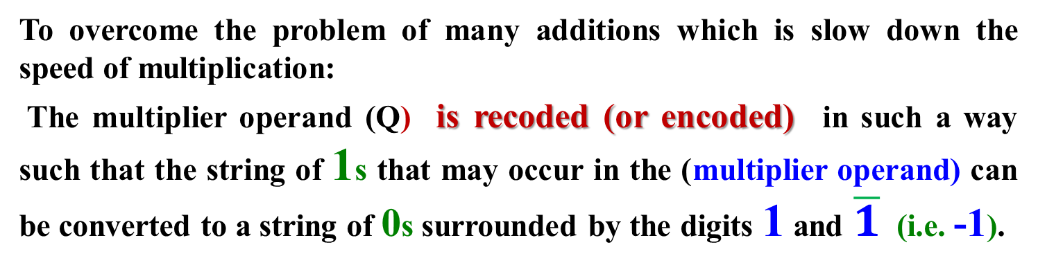
Speeding up Multiplier
To overcome the problem of many additions which is slow down the speed of multiplication:
The multiplier operand (Q) is recoded (or encoded) in such a way such that the string of 1s that may occur in the (multiplier operand) can be converted to a string of 0s surrounded by the digits 1 and $\overline{1}$ (i.e. -1).
*This encoded technique used here is called “Booth Recoding (or encoding)”.
Booth recoding is used with any multiplier type and for unsigned and signed numbers (i.e. the numbers enter to the multiplier circuit are assumed to be 2’s complement numbers)

Slide 8
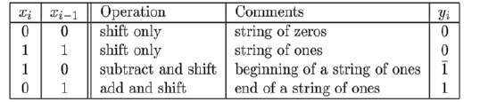
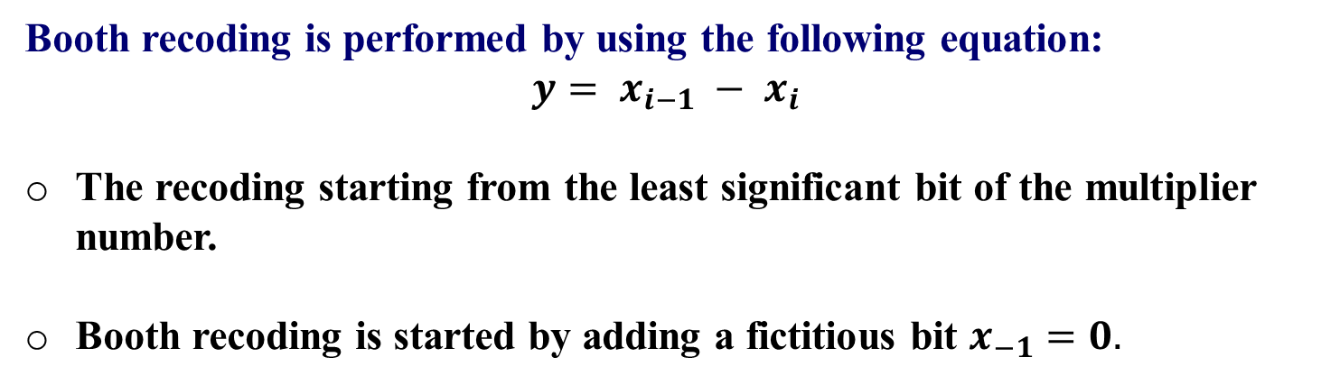
Booths Algorithm- Rules
Booth recoding is performed by using the following equation:
$$y= x_{i−1} − x_{i}$$
The recoding starting from the least significant bit of the multiplier number.
Booth recoding is started by adding a fictitious bit $x_{−1}=0.$

Slide 9

Aside
Example: Recode the following multiplier Number: X= 0011110011
Solution: Add the reference bit in the least significant position, then start the recoding operation.
i.e. X= 0011110011(0)
x₋₁
$Y$= 01000$\overline{1}$010 $\overline{1}$
4- add/ or subtracts operations instead of 6- additions
Example: Recode the multiplier No. X= 1 1 0 1 1 1 0 0 -36₁₀
Negative No., since the MSB is equal to 1
X= 11011100(0) $Y$= 0$\overline{1}$100$\overline{1}$00 Y= (-64) +32 + (-4) = -36

Slide 10
Return
Booth recoding can be implemented by modifying the sequential multiplier hardware. This is done by:
* Extending the Q- register size from n-bit to( n+1) bits so that the extra position will initially hold the fictitious “0" .
* Makes the n-bit parallel adder to perform add / subtract.

Slide 11
n+1
M
A
Q
n
n
q₋₁
(n) bit add/ (or subtract
n
Fig. An (nXn) Signed Sequential multiplier using Booth Recoding

Slide 12
n

Slide 13
Example: Multiply the following numbers M= -4₁₀ and Q= 7₁₀
M= -4₁₀ = (1100) in 2’s complement representation
and Q= 7₁₀ = (0111)
Size | Q q₀ q₋₁ | A | M | Comments
4 | 0 1 1 1(0) | 0000 | 1100 | Initialization

Slide 14
Size | Q q₀ q₋₁ | A | M | Comments
4 | 0 1 1 1(0) | 0000 | 1100 | Initialization
3 | 01110 00111 | 0100 0010 | 1100 1100 | Iteration 1: since q₀q₋₁=10 i -A= A-M =(0000-1100) ii – ShR(AQ)

Slide 15
Size | Q | A | M | Comments
4 | 0 1 1 1(0) | 0000 | 1100 | Initialization
3 | 01110 001 11 | 0100 0010 | 1100 1100 | Iteration 1: since q₀q₋₁=10 i -A= A-M ii – ShR(AQ)
2 | 00011 | 0001 | 1100 | Iteration 2: q₀q₋₁=11 i - ShR(AQ)

Slide 16
Size | Q | A | M | Comments
4 | 0 1 1 1(0) | 0000 | 1100 | Initialization
3 | 01110 001 11 | 0100 0010 | 1100 1100 | Iteration 1: since q₀q₋₁ =10 i -A= A-M ii – ShR(AQ)
2 | 00011 | 0001 | 1100 | Iteration 2: q₀q₋₁=11 i - ShR(AQ)
1 | 10001 | 0000 | 1100 | Iteration 3: q₀q₋₁= 11 i -ShR(AQ)

Slide 17
Size | Q | A | M | Comments
4 | 0 1 1 1(0) | 0000 | 1100 | Initialization
3 | 01110 001 11 | 0100 0010 | 1100 1100 | Iteration 1: since q₀q₋₁=10 i -A= A-M ii – ShR(AQ)
 | 00011 | 0001 | 1100 | Iteration 2: q₀q₋₁=11 i - ShR(AQ)
1 | 10001 | 0000 | 1100 | Iteration 3: q₀q₋₁= 11 i -ShR(AQ)
0 | 10001 0100 0 | 1100 1110 | 1100 | Iteration 4: since q₀q₋₁=01 i - A=A+M= 0000+1100 ii - ShR(AQ)
Result= 11100100 = -28₁₀

Slide 18
Division Algorithms
Division is the most complex of the four basic arithmetic operations and the hardest one to speedup. Thus, dividers are more expensive and/ or slower than multipliers.
Several classes of algorithms exist for this operation like:
i- Restoring Division Algorithm
ii- Non- Restoring Division Algorithm
iii- SRT Division Algorithm
The implementation of these algorithms can be either sequential, combinational, or both.
Sequential Divider
The implementation of this divider consists of n- iterations of the recurrence. This means that the H/W of the recurrence step is reused for all the iterations and the partial remainder (PR) and the final remainder is updated in a register.

Slide 19
In general, dividing two number unsigned integer numbers using division algorithm will provide a quotient and a remainder.
Consider unsigned integer Numbers:
Perform the division operation (D/X) , such that D= Q.X + R
where D: Dividend X: Divisor Q: Quotient R: Remainder
and 0 ≤ R ≤ D
Note:
In the digit recurrence algorithms for binary system, a 1-digit (1 bit)/ iteration is generated.

Slide 20
i) Restoring Division Algorithm:
When dividing two (n- bit) unsigned Integer numbers, three (n- bit) registers are needed, namely X, A, Q:
1- Register X: used to hold the divisor
2- Register A: Accumulator is initialized with zero value . When the algorithm finished it will hold the remainder (R) result.
3- Register Q: hold the dividend initially. When the algorithm finished it will hold the quotient (Q) result.
The basic steps of the restoring division algorithm that repeated n- times are:
i- Shift the register pair (AQ) to left
ii- Subtract the divisor (X) from (A): A= A - X
iii- If the result of subtraction is positive, set Q[0] =1; else clear Q[0] =0.

Slide 21
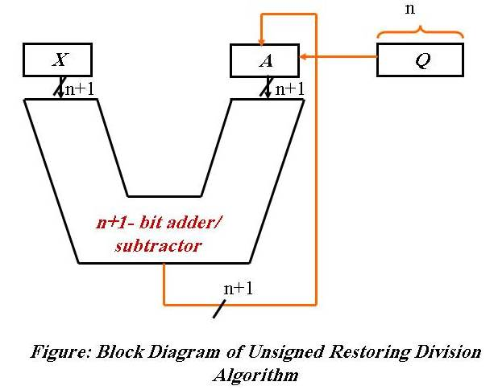
Example:
Using restoring division algorithm Divide 19/3

Slide 22
Size (n) | Q (n) | A (n+1) | X (n+1) | Comments
5 | 10011 | 000000 | 000011 | Initialization

Slide 23
Size (n) | Q (n) | A (n+1) | X (n+1) | Comments
5 | 10011 | 000000 | 000011 | Initialization
4 | 0011? 0011? 00110 | 000001 111110 000001 | 000011 | I 1: i ) ShL(AQ) ii ) A= A-X iii)since A is –ve, Restore A & Q[0] =0

Slide 24
Size (n) | Q (n) | A (n+1) | X (n+1) | Comments
5 | 10011 | 000000 | 000011 | Initialization
4 | 0011? 0011? 00110 | 000001 111110 000001 | 000011 | I 1: i – ShL(AQ) ii)A= A-X iii) Since A is –ve, Restore A & Q[0] =0
3 | 0110? 0110? 01100 | 000010 111111 000010 | 000011 | I 2: i) ShL(AQ) ii) A= A-X iii) Since A is –ve, Restore A & Q[0] =0

Slide 25
Size (n) | Q (n) | A (n+1) | X (n+1) | Comments
5 | 10011 | 000000 | 000011 | Initialization
4 | 0011? 0011? 00110 | 000001 111110 000001 | 000011 | I 1: i) ShL(AQ) ii) A= A-X iii) Since A is –ve, Restore A & Q[0] =0
3 | 0110? 0110? 01100 | 000010 111111 000010 | 000011 | I 2: i) ShL(AQ) ii) A= A-X iii) Since A is –ve, Restore A & Q[0] =0
2 | 1100? 1100? 11001 | 000100 000001 000001 | 000011 | I 3: i) ShL(AQ) ii) A= A-X iii) Since A is +ve, Q[0] =1

Slide 26
Size (n) | Q (n) | A (n+1) | X (n+1) | Comments
5 | 10011 | 000000 | 000011 | Initialization
4 | 0011? 0011? 00110 | 000001 111110 000001 | 000011 | I 1: i – ShL(AQ) ii -A= A-X iii- Restore A & Q[0] =0
3 | 0110? 0110? 01100 | 000010 111111 000010 | 000011 | I 2: i – ShL(AQ) ii -A= A-X iii- Restore A & Q[0] =0
2 | 1100? 1100? 11001 | 000100 000001 000001 | 000011 | I 3: i – ShL(AQ) ii -A= A-X iii- Q[0] =1
1 | 1001? 1001? 10011 | 000011 000000 000000 | 000011 | I 3: i – ShL(AQ) ii -A= A-X iii- Since A is +ve, Q[0] =1

Slide 27
Size (n) | Q (n) | A (n+1) | X (n+1) | Comments
5 | 10011 | 000000 | 000011 | Initialization
4 | 0011? 0011? 00110 | 000001 111110 000001 | 000011 | I 1: i – ShL(AQ) ii -A= A-X iii) Since A is –ve, Restore A & Q[0] =0
3 | 0110? 0110? 01100 | 000010 111111 000010 | 000011 | I 2: i) ShL(AQ) ii) A= A-X iii)Since A is –ve, Restore A & Q[0] =0
2 | 1100? 1100? 11001 | 000100 000001 000001 | 000011 | I 3: i ) ShL(AQ) ii) A= A-X iii) Since A is +ve, Q[0] =1
1 | 1001? 1001? 10011 | 000011 000000 000000 | 000011 | I 3: i) ShL(AQ) ii ) A= A-X iii) Since A is +ve, Q[0] =1
0 | 0011? 0011? 00110 | 000001 111110 000001 | 000011 | I 4: i – ShL(AQ) ii) A= A-X iii) Since A is –ve, Restore A & Q[0] =0
Remainder
Quotient

Slide 28
ii- Non- Restoring Division Algorithm
The restoring division algorithm needs n- subtractions and extra additions when dividing two n-bit numbers.
The speed of the restoring division algorithm can be improved by eliminating the restoration step.
This elimination can be done if step3 in the restoring division algorithm is performed first, step 1, then step2, and computation starts immediately after the subtraction:

Slide 29
Under this condition, one of the following must be performed:
i- if sign of A is positive, then: a- ShL(AQ)
b -A= A-X
c- Since A[4]=1, set Q[0] =0
ii- if sign of A is negative, then: a– ShL(AQ)
b-A= A+X
c- Since A[4]=0 , set Q[0] =1
Example: Using non-restoring division algorithm, perform the division operation 11/3

Slide 30
Size | Q (n-bit) | A (n+1) bit | X (n+1) bit | Comments
4 | 1011 | 00000 | 00011 | Initialization
3 | 011? 011? 0110 | 00001 11110 11110 | 00011 | I1: Since A[4]= 0: i – ShL(AQ) ii -A= A-X iii- Since A[4]=1, set Q[0] =0
2 | 110? 110? 1100 | 11100 11111 11111 | 00011 | I2: Since A[4]= 1: i – ShL(AQ) ii -A= A+X iii- Since A[4]=1 , set Q[0] =0
1 | 100? 100? 1001 | 11111 00010 00010 | 00011 | I3: Since A[4]= 1: i – ShL(AQ) ii -A= A+X iii- Since A[4]=0 , set Q[0] =1
0 | 001? 001? 0011 | 00101 00010 00010 | 00011 | I4: Since A[4]= 0: i – ShL(AQ) ii -A= A-X iii- Since A[4]=0, set Q[0] =1
Remainder
Quotient

